Slide 1
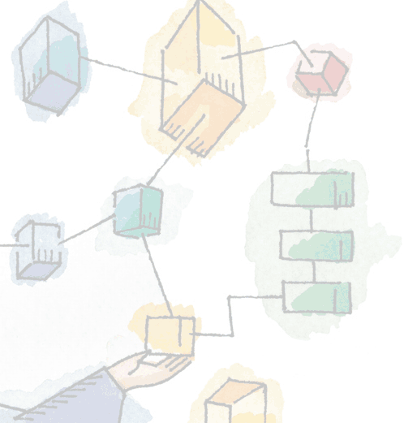
Chapter 2 Operating System Overview
-- Ankit P. Vaishnav

Slide 2
Operating System
A program that controls the execution of application programs
An interface between applications and hardware
Main objectives of an OS:
Convenience - Makes computer easy to use
Efficiency - Manages resources efficiently
Ability to evolve – Easy to adapt changes
Notes:
An OS is a program that controls the execution of application programs and acts as an interface between applications and the computer hardware.
It can be thought of as having three objectives:
Convenience:
An OS makes a computer more convenient to use.
Efficiency:
An OS allows the computer system resources to be used in an efficient manner.
Ability to evolve:
An OS should be constructed in such a way as to permit the effective development, testing, and introduction of new system functions without interfering with service.

Slide 3
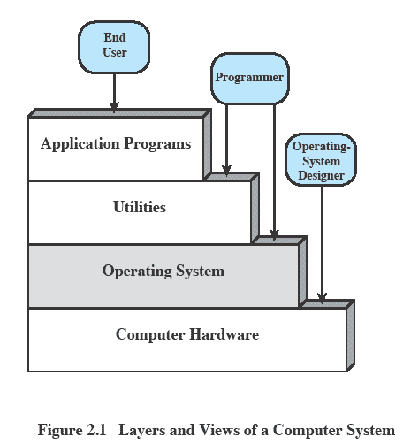
Layers and Views
Notes:
The hardware and software used in providing applications to a user can be viewed in a layered or hierarchical fashion, as depicted here.
The user of those applications, the end user, generally is not concerned with the details of computer hardware.
The end user views a computer system in terms of a set of applications.
An application can be expressed in a programming language and is developed by an application programmer.
If one were to develop an application program as a set of machine instructions that is completely responsible for controlling the computer hardware, one would be faced with an overwhelmingly complex undertaking.
The most important collection of system programs comprises the OS.
The OS masks the details of the hardware from the programmer and provides the programmer with a convenient interface for using the system.
It acts as mediator, making it easier for the programmer and for application programs to access and use those facilities and services.

Slide 4
Services Provided by the Operating System
Program development
Editors and debuggers.
Program execution
OS handles scheduling of numerous tasks required to execute a program
Access I/O devices
Each device will have unique interface
OS presents standard interface to users
Notes:
Program development:
The OS provides a variety of facilities and services, such as editors and debuggers, to assist the programmer in creating programs.
Typically, these services are in the form of utility programs that, while not strictly part of the core of the OS, are supplied with the OS and are referred to as application program development tools.
Program execution:
A number of steps need to be performed to execute a program.
Instructions and data must be loaded into main memory, I/O devices and files must be initialized, and other resources must be prepared.
The OS handles these scheduling duties for the user.
Access to I/O devices:
Each I/O device requires its own peculiar set of instructions or control signals for operation.
The OS provides a uniform interface that hides these details so that programmers can access such devices using simple reads and writes.

Slide 5
Services cont…
Controlled access to files
Accessing different media but presenting a common interface to users
Provides protection in multi-access systems
System access
Controls access to the system and its resources
Notes:
Controlled access to files:
For file access, the OS must reflect a detailed understanding of not only the nature of the I/O device (disk drive, tape drive) but also the structure of the data contained in the files on the storage medium.
In the case of a system with multiple users, the OS may provide protection mechanisms to control access to the files.
• System access:
For shared or public systems, the OS controls access to the system as a whole and to specific system resources.
The access function must provide protection of resources and data from unauthorized users and must resolve conflicts for resource contention.

Slide 6
Services cont…
Error detection and response
Internal and external hardware errors (Ex: memory / Device failure)
Software errors (Ex: Divide by zero)
Accounting
Collect usage statistics (Ex: Response Time)
Monitor performance
Notes:
Error detection and response:
A variety of errors can occur while a computer system is running.
These include internal and external hardware errors, such as a memory error, or a device failure or malfunction;
and various software errors, such as division by zero, attempt to access forbidden memory location, and inability of the OS to grant the request of an application.
In each case, the OS must provide a response that clears the error condition with the least impact on running applications.
The response may range from ending the program that caused the error, to retrying the operation, to simply reporting the error to the application.
Accounting:
A good OS will collect usage statistics for various resources and monitor performance parameters such as response time.
On any system, this information is useful in anticipating the need for future enhancements and in tuning the system to improve performance.
On a multiuser system, the information can be used for billing purposes.

Slide 7
The Role of an OS
A computer is a set of resources for the
movement,
storage and
processing of data
The OS is responsible for managing these resources. – Hence OS is called resource manager

Slide 8
Operating System as Software
The OS functions in the same way as an ordinary computer software
It is a program that is executed by the CPU
Operating system relinquishes control of the processor and regains when needed
Notes:
The OS functions in the same way as ordinary computer software;
It is a program or suite of programs executed by the processor.
The OS frequently relinquishes control and must depend on the processor to allow it to regain control.

Slide 9
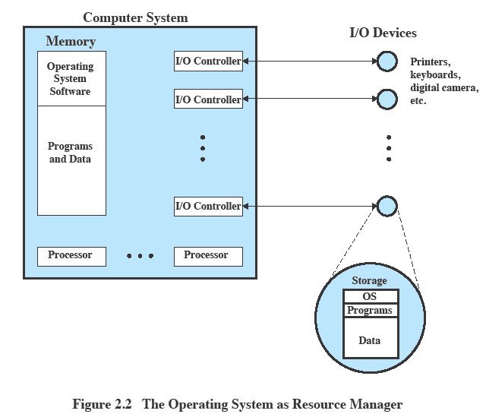
OS as Resource Manager
Notes:
This figure suggests the main resources that are managed by the OS.
A portion of the OS is in main memory.
This includes the kernel, or nucleus, which contains the most frequently used functions in the OS
and other portions of the OS currently in use.
The remainder of main memory contains user programs and data.
The allocation of this resource (main memory) is controlled jointly by the OS and memory management hardware in the processor.
The OS decides when an I/O device can be used by a program in execution and controls access to and use of files.
The processor itself is a resource, and the OS must determine how much processor time is to be devoted to the execution of a particular user program.
In the case of a multiple-processor system, this decision must span all of the processors.

Slide 10
Evolution of Operating Systems
Operating systems have evolved over time
Hardware upgrades plus new types of hardware
New services
Fixes
Notes:
Hardware upgrades plus new types of hardware:
e.g. early versions of UNIX and the Macintosh operating system did not employ a paging mechanism because they were run on processors without paging hardware.
Subsequent versions of these operating systems were modified to exploit paging capabilities.
Also, the use of graphics terminals and page-mode terminals instead of line-at-a-time scroll mode terminals affects OS design.
For example, a graphics terminal typically allows the user to view several applications at the same time through “windows” on the screen.
This requires more sophisticated support in the OS.
New services:
In response to user demand or in response to the needs of system managers, the OS expands to offer new services.
e.g. if it is found to be difficult to maintain good performance for users with existing tools, new measurement and control tools may be added to the OS.
Fixes:
Any OS has faults.
These are discovered over the course of time and fixes are made.
Of course, the fix may introduce new faults.

Slide 11
Evolution of Operating Systems
It may be easier to understand the key requirements of an OS by considering the evolution of Operating Systems
Evolution stages include
Serial Processing
Simple Batch Systems
Multiprogrammed batch systems
Time Sharing Systems
Notes:
In attempting to understand the key requirements for an OS and the significance of the major features of a contemporary OS, it is useful to consider how operating systems have evolved over the years.

Slide 12
Serial Processing
No operating system
Machines run from a console with
display lights,
toggle switches,
input device and
printer
Notes:
With the earliest computers (late 1940s to the mid-1950s), the programmer interacted directly with the computer hardware;
There was no OS.
These computers were run from a console consisting of display lights, toggle switches, some form of input device, and a printer.
Programs in machine code were loaded via the input device (e.g., a card reader).
If an error halted the program, the error condition was indicated by the lights.
If the program proceeded to a normal completion, the output appeared on the printer.
These early systems presented two main problems:
Scheduling:
Most installations used a hardcopy sign-up sheet to reserve computer time.
Typically, a user could sign up for a block of time in multiples of a half hour or so.
A user might sign up for an hour and finish in 45 minutes; this would result in wasted computer processing time.
On the other hand, the user might run into problems, not finish in the allotted time, and be forced to stop before resolving the problem.
Setup time:
A single program, called a job, could involve loading the compiler plus the high-level language program (source program) into memory, saving the compiled program (object program) and then loading and linking together the object program and common functions.
Each of these steps could involve mounting or dismounting tapes or setting up card decks.
If an error occurred, the hapless user typically had to go back to the beginning of the setup sequence.
Thus, a considerable amount of time was spent just in setting up the program to run

Slide 13
Serial Processing Issues
Scheduling
User assigned fixed amount of time
Problem when more or less time is used
Setup time
– Loading of compiler and program can be time consuming

Slide 14
Simple batch system
Early computers were extremely expensive
Important to maximize processor utilization
Hence Concept of Monitor was introduced
Software that controls the sequence of events
Batch jobs together
Program returns control to monitor when finished
Notes:
Early computers were very expensive, and therefore it was important to maximize processor utilization.
The wasted time due to scheduling and setup time was unacceptable.
To improve utilization, the concept of a batch operating system was developed.
The central idea behind the simple batch-processing scheme is the use of a piece of software known as the monitor.
With this type of OS, the user no longer has direct access to the processor.
Instead, the user submits the job on cards or tape to a computer operator, who batches the jobs together sequentially and places the entire batch on an input device, for use by the monitor.
Each program is constructed to branch back to the monitor when it completes processing, at which point the monitor automatically begins loading the next program.

Slide 15
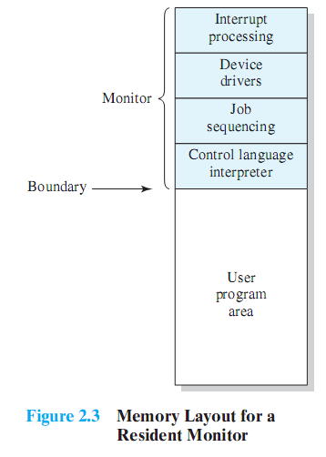
Monitor’s perspective
Monitor controls the sequence of events
Resident Monitor is software always in memory
Monitor reads in job and gives control
Job returns control to monitor
Notes:
Monitor point of view: The monitor controls the sequence of events.
Much of the monitor must always be in main memory and available for execution (Figure 2.3).
That portion is referred to as the resident monitor.
The rest of the monitor consists of utilities and common functions that are loaded as subroutines to the user program at the beginning of any job that requires them.
The monitor reads in jobs one at a time from the input device
As it is read in, the current job is placed in the user program area, and control is passed to this job.
When the job is completed, it returns control to the monitor, which immediately reads in the next job.
The results of each job are sent to an output device, such as a printer, for delivery to the user.

Slide 16
Modes of Operation
User Mode
User program executes in user mode
Kernel Mode
Monitor executes in kernel mode
Privileged instructions may be executed, all memory accessible.
Notes:
Considerations of memory protection and privileged instructions lead to the concept of modes of operation.
A user program executes in a user mode, in which certain areas of memory are protected from the user’s use and in which certain instructions may not be executed.
The monitor executes in a system mode, or what has come to be called kernel mode, in which privileged instructions may be executed
and in which protected areas of memory may be accessed.

Slide 17
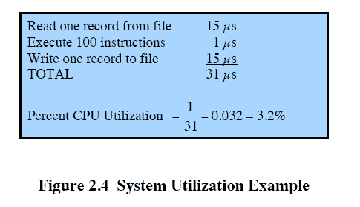
Simple Batch System Issues
CPU is often idle
Even with automatic job sequencing.
I/O devices are slow compared to processor
Notes:
Even with the automatic job sequencing provided by a simple batch operating system, the processor is often idle.
The problem is that I/O devices are slow compared to the processor.
Figure 2.4 details a representative calculation.
The calculation concerns a program that processes a file of records and performs, on average, 100 machine instructions per record.
In this example the computer spends over 96% of its time waiting for I/O devices to finish transferring data to and from the file.

Slide 18

Uniprogramming
Processor must wait for I/O instruction to complete before preceding
Notes:
In a single application system, uniprogramming, the processor spends a certain amount of time executing, until it reaches an I/O instruction.
It must then wait until that I/O instruction concludes before proceeding.
This inefficiency is not necessary.

Slide 19
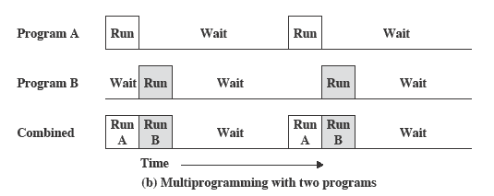
Multiprogramming
When one job needs to wait for I/O, the processor can switch to the other job
No user interaction
Notes:
We know that there must be enough memory to hold the OS (resident monitor) and one user program.
Suppose that there is room for the OS and two user programs.
When one job needs to wait for I/O, the processor can switch to the other job, which is likely not waiting for I/O (Figure 2.5b).

Slide 20
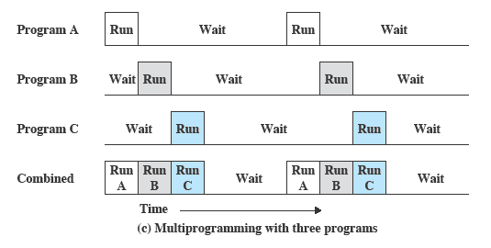
Multi-programmed Batch Systems
Notes:
Further-more, we might expand memory to hold three, four, or more programs and switch among all of them (Figure 2.5c).
The approach is known as multiprogramming, or multitasking.
It is the central theme of modern operating systems.

Slide 21
Time Sharing Systems
Using multiprogramming to handle multiple interactive jobs
Multiple users simultaneously access the system through terminals
Notes:
With the use of multiprogramming, batch processing can be quite efficient.
However, for many jobs, it is desirable to provide a mode in which the user interacts directly with the computer.
Indeed, for some jobs, such as transaction processing, an interactive mode is essential.
Today, the requirement for an interactive computing facility can be, and often is, met by the use of a dedicated personal computer or workstation.
That option was not available in the 1960s, when most computers were big and costly.
Instead, time sharing was developed.
The technique is referred to as time sharing, because processor time is shared among multiple users.
In a time-sharing system, multiple users simultaneously access the system through terminals, with the OS interleaving the execution of each user program in a short burst or quantum of computation.

Slide 22
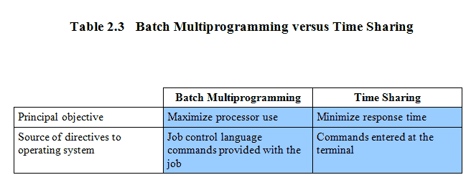
Batch Multiprogramming vs. Time Sharing
Notes:
Both batch processing and time sharing use multiprogramming.
The key differences are listed here

Slide 23
Problems and Issues
Multiple jobs in memory must be protected from each other’s data
File system must be protected so that only authorised users can access
Contention for resources must be handled
Printers, storage etc
Notes:
Time sharing and multiprogramming raise a host of new problems for the OS.
If multiple jobs are in memory, then they must be protected from interfering with each other by, for example, modifying each other’s data.
With multiple interactive users, the file system must be protected so that only authorized users have access to a particular file.
The contention for resources, such as printers and mass storage devices, must be handled.

Slide 24
Symmetric multiprocessing (SMP)
An SMP system has
multiple processors
These processors share same main memory and I/O facilities
All processors can perform the same functions
The OS of an SMP schedules processes or threads across all of the processors.
Notes:
Vendors have now introduced computers with multiple microprocessors.
To achieve greater efficiency and reliability, one technique is to employ symmetric multiprocessing (SMP),
SMP refers to a computer hardware architecture and also to the OS behavior that exploits that architecture.
A symmetric multiprocessor can be defined as a standalone computer system with the following characteristics:
1. There are multiple processors.
2. These processors share the same main memory and I/O facilities, interconnected by a communications bus or other internal connection scheme.
3. All processors can perform the same functions (hence the term symmetric).
The OS of an SMP schedules processes or threads across all of the processors.

Slide 25
SMP Advantages
Performance
Allowing parallel processing
Availability
Failure of a single process does not halt the system
Incremental Growth
Additional processors can be added.
Notes:
SMP has a number of potential advantages over uniprocessor architecture, including the following:
Performance:
If the work to be done by a computer can be organized so that some portions of the work can be done in parallel, then a system with multiple processors will yield greater performance than one with a single processor of the same type.
Availability: In a symmetric multiprocessor, because all processors can perform the same functions, the failure of a single processor does not halt the system.
Instead, the system can continue to function at reduced performance.
Incremental growth: A user can enhance the performance of a system by adding an additional processor.
Scaling: Vendors can offer a range of products with different price and performance characteristics based on the number of processors configured in the system.

Slide 26
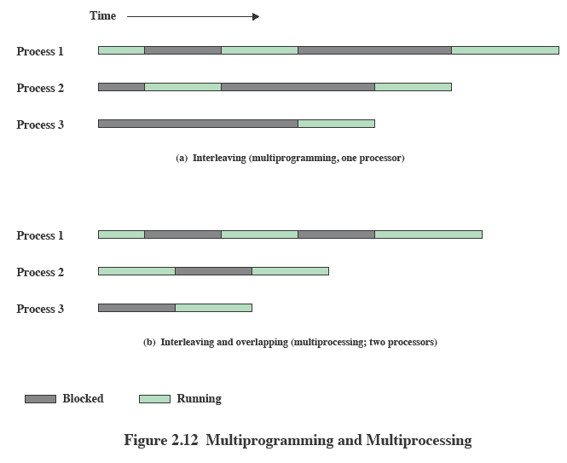
Multiprogramming and Multiprocessing
Notes:
With multiprogramming, only one process can execute at a time;
meanwhile all other processes are waiting for the processor.
With multiprocessing, more than one process can be running simultaneously, each on a different processor.

Slide 27
Distributed Operating Systems
Provides the illusion of
a single main memory space and
single secondary memory space
Early stage of development
Notes:
A distributed operating system provides the illusion of a single main memory space and a single secondary memory space, plus other unified access facilities, such as a distributed file system.
Although clusters are becoming increasingly popular, the state of the art for distributed operating systems lags that of uniprocessor
and SMP operating systems.

Slide 28
Real Time Operating Systems
A Real Time Operating System, commonly known as an RTOS,
Is a software component that rapidly switches between tasks,
Giving the impression that multiple programs are being executed at the same time on a single processing core.

Slide 29
Real Time Operating Systems
In actual fact the processing core can only execute one program at any one time,
And what the RTOS is actually doing is rapidly switching between individual programming threads (or Tasks)
To give the impression that multiple programs are executing simultaneously.

Slide 30
System Calls
Definition:
Programming interface to the services provided by the OS
Typically written in a high-level language (C or C++)
Use:
Mostly accessed by programs via a high-level Application Programming Interface (API) rather than direct system call use

Slide 31
System Calls
Three most common APIs are
Win32 API for Windows,
POSIX API for POSIX-based systems (including virtually all versions of UNIX, Linux, and Mac OS X),
Java API for the Java virtual machine (JVM)

Slide 32
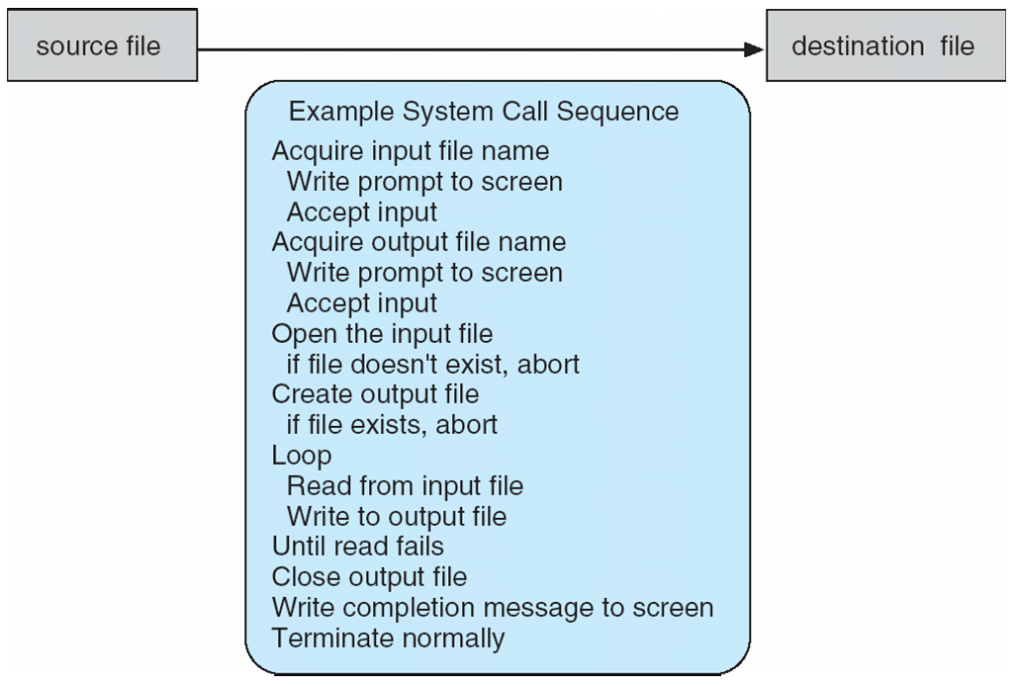
Example of System Calls
System call sequence to copy the contents of one file to another file

Slide 33
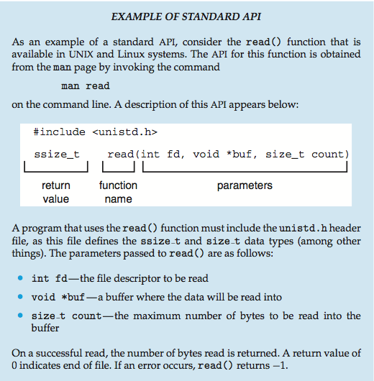

Slide 34
System Call Implementation
Typically, a number associated with each system call
System-call interface maintains a table indexed according to these numbers
The system call interface invokes the intended system call in OS kernel and returns status of the system call and any return values

Slide 35
System Call Implementation
The caller need know nothing about how the system call is implemented
Just needs to obey API and understand what OS will do as a result call
Most details of OS interface hidden from programmer by API
Managed by run-time support library (set of functions built into libraries included with compiler)

Slide 36
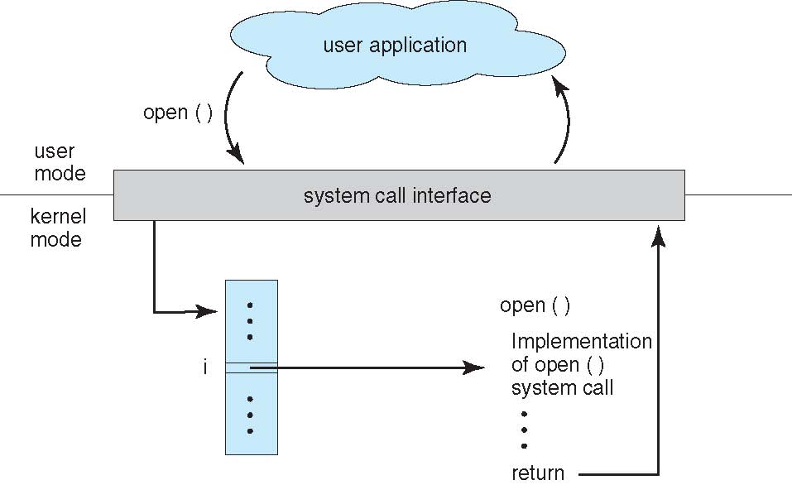
API – System Call – OS Relationship

Slide 37
Types of System Calls
File management
create file, delete file
open, close file
read, write, reposition
get and set file attributes
Device management
request device, release device
read, write, reposition
get device attributes, set device attributes
logically attach or detach devices

Slide 38
Types of System Calls
Information maintenance
get time or date, set time or date
get system data, set system data
get and set process, file, or device attributes
Communications
create, delete communication connection
send, receive messages
transfer status information
attach and detach remote devices

Slide 39
Types of System Calls
Protection
Control access to resources
Get and set permissions
Allow and deny user access

Slide 40
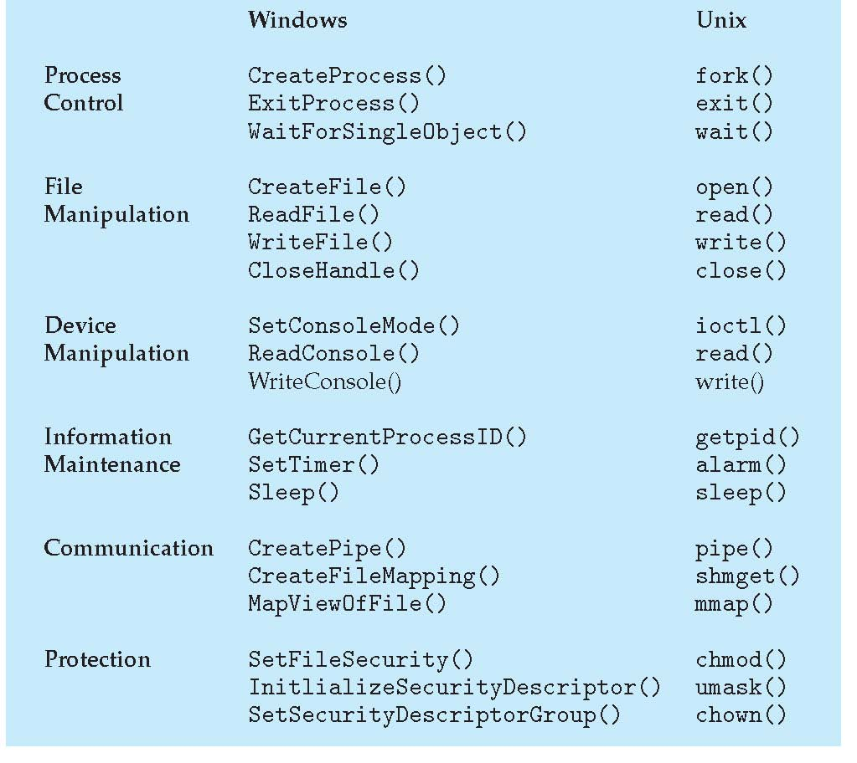
Examples of Windows and Unix System Calls

Slide 41
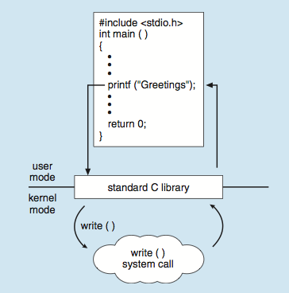
Standard C Library Example

Slide 42
References
Operating Systems: Internals and Design Principles by William Stallings (6th Edition)
Operating System Concepts by Silberschatz, Galvin and Gagne (9th Edition)

